Slide 1



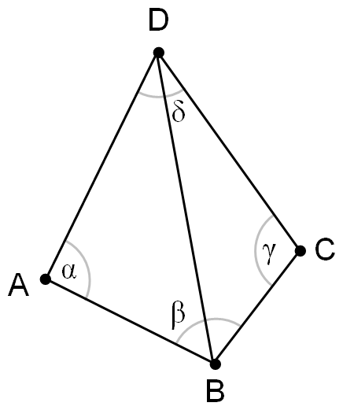
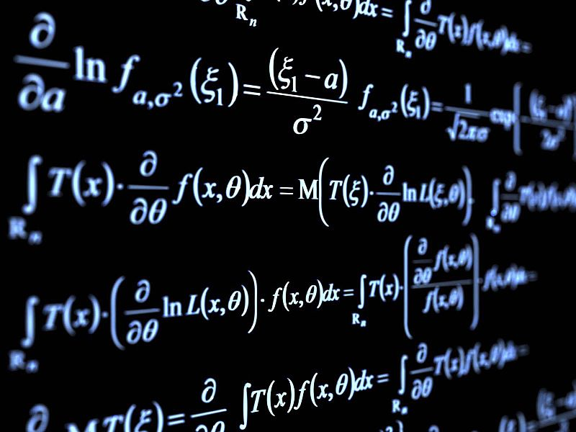
Math for Developers
Basic Mathematical Concepts for Programmers
Programming
Basics
SoftUni Team
Technical Trainers
Software University
http://softuni.bg

Slide 2

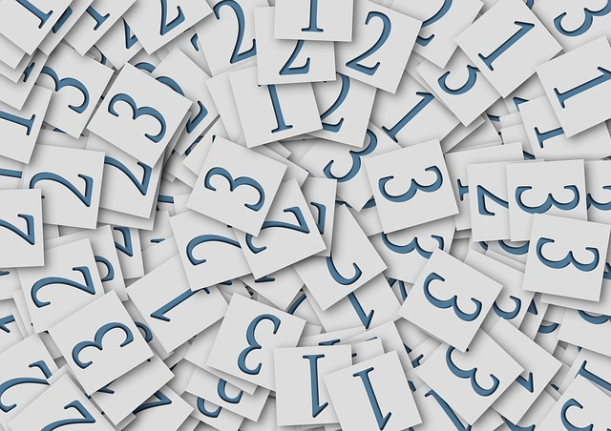
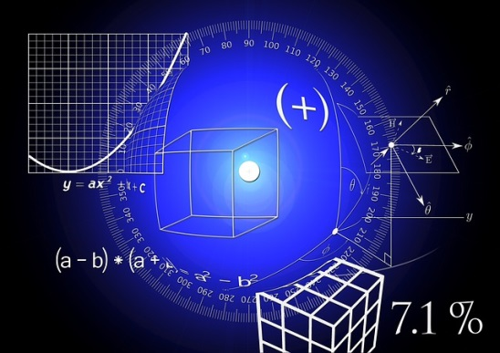
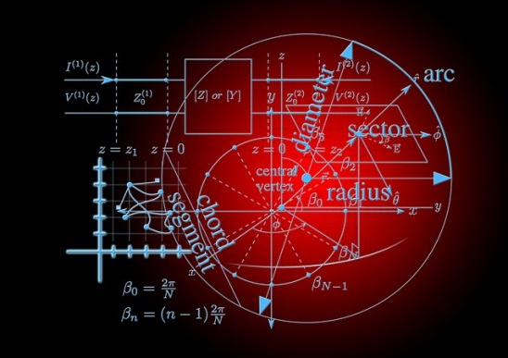
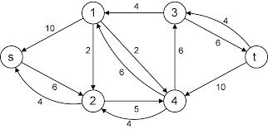
Table of Contents
Mathematical Definitions
Geometry and Trigonometry Basics
Numeral Systems
Algorithms

Slide 3
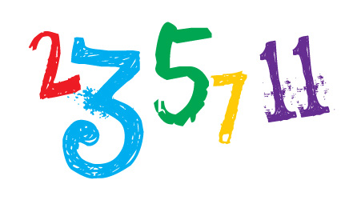
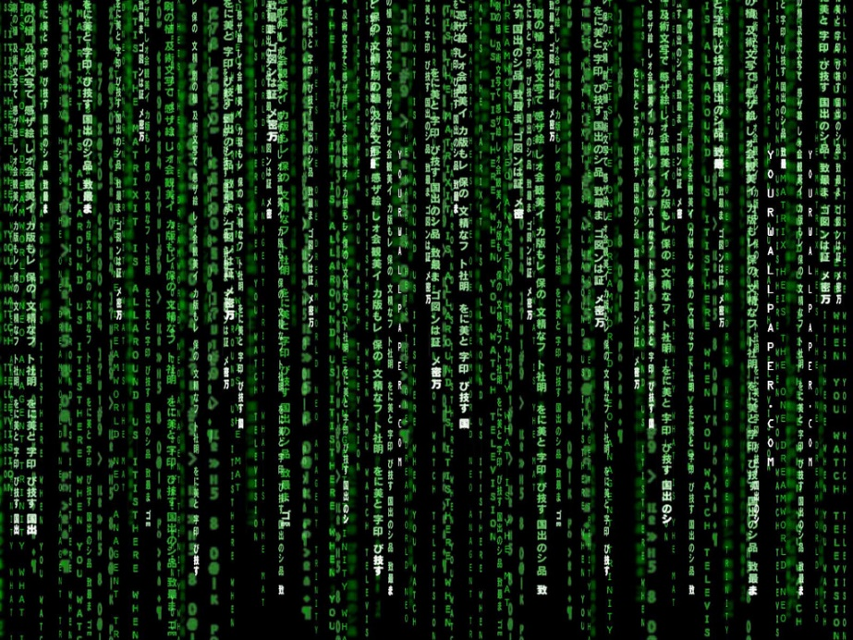
Mathematical Definitions

Slide 4
Mathematical Definitions
Prime numbers
Any number can be presented as product of Prime numbers
Number sets
Basic sets (Natural, Integers, Rational, Real)
Other sets (Fibonacci, Tribonacci)
Factorial (n!)
Vectors and Matrices

Slide 5

Prime Numbers
A prime number is a natural number that can be divided only by 1 and by itself
Examples: 2, 3, 5, 7, 11, 47, 73, 97, 719, 997
Largest known prime as of now has 17,425,170 digits!
Any non-prime integer can be presented as product of primes
Examples: 6 = 2 x 3, 24 = 2 x 2 x 2 x 3, 95 = 5 x 19
Non-prime numbers are called composite numbers

Slide 6


Number Sets
Natural numbers
Used for counting and ordering
Comprised of prime and composite numbers
The basis of all other numbers
Examples: 1, 3, 6, 14, 27, 123, 5643
Integer numbers
Numbers without decimal or fractional part
Comprised of 0, natural numbers and their additive inverses (opposites)
Examples: -2, 1024, 42, -154, 0

Slide 7


Number Sets
Rational numbers
Any number that can be expressed as fraction of two integer numbers
The denominator should not be 0
Examples: ¾, ½, 5/8, 11/12, 123/456
Real numbers
Used for measuring quantity
Comprised of all rational and irrational numbers
Examples: 1.41421356…, 3.14159265…

Slide 8
Number Sets
Rational Numbers
Natural Numbers
Prime Numbers
Integer Numbers
Real Numbers

Slide 9
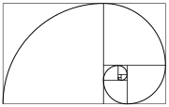
Number Sets
Fibonacci numbers
A set of numbers, where each number is the sum of first two
Rational approximation of the golden ratio
Example: 0, 1, 1, 2, 3, 5, 8, 13, 21, 34, 55,…
Tribonacci numbers
A set of numbers, where each number is the sum of first three
Example: 0, 1, 1, 2, 4, 7, 13, 24, 44, 81, …

Slide 10
Factorial
n! – the product of all positive integers, less than or equal to n
n should be non-negative
n! = (n – 1)! x n
Example: 5! = 5 x 4 x 3 x 2 x 1 = 120
20! = 2,432,902,008,176,640,000
Used as classical example for recursive computation

Slide 11
Vectors and Matrices
Matrix is a rectangular array of numbers, symbols, or expressions, arranged in rows and columns
Row vector is a 1 × m matrix, i.e. a matrix consisting of a single row of m elements
Column vector is a m × 1 matrix, i.e. a matrix consisting of a single column of m elements
| 2 4.5 17.6 |
A = | 1.2 6 -2.3 |
| -11 6.1 21 |
X = [ x1 x2 x3 ... Xm ]
| x1 |
| x2 |
X = | x3 |
| ... |
| xm |

Slide 12
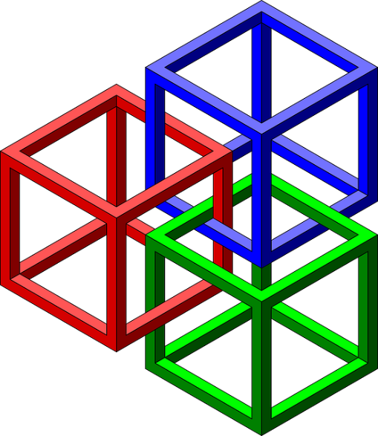

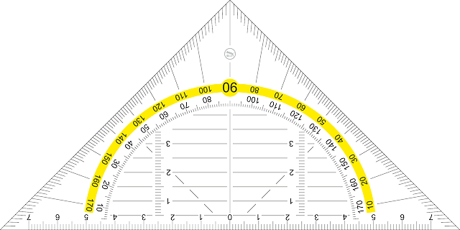
Geometry

Slide 13
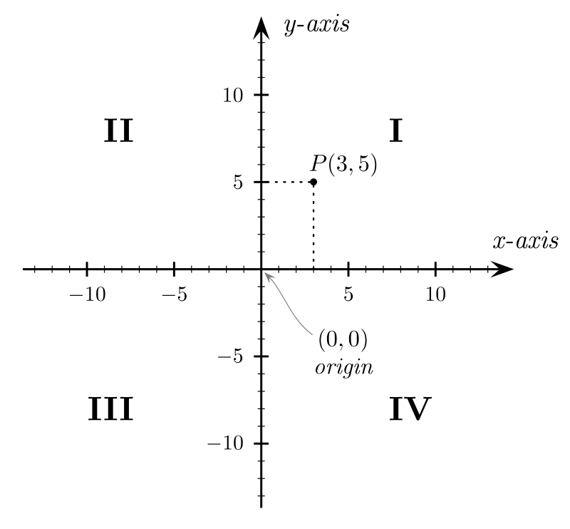
Cartesian Coordinate System
Specifies each point uniquely in a plane
By a pair of numerical coordinates
Representing signed distances
The base point is called origin
Can be divided in 4 quadrants
Useful for:
Drawing on canvas
Placement and styling in HTML/CSS

Slide 14
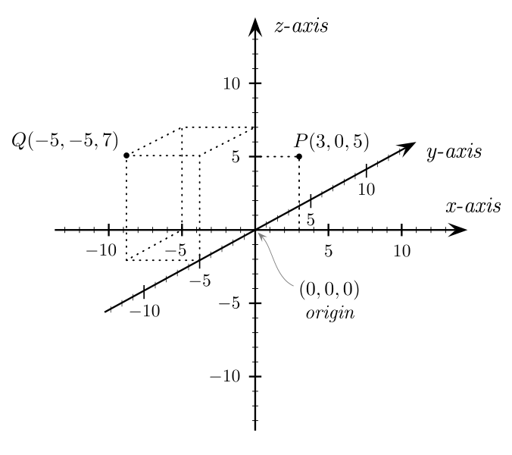
Cartesian Coordinate System 3D
Specifies each point uniquely in the space
By numerical coordinates
Signed distances to three mutually perpendicular planes
Useful for:
Interacting with the real world
Calculating distances in 3D graphics
3D modeling and animations

Slide 15
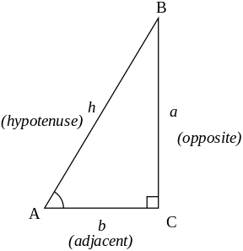
Trigonometric Functions
Define the correlation between the angles and the lengths of the sides of a right-angled triangle
Useful for:
Positioning in navigation systems
Calculating distances in 3D graphics
Modeling sound waves
α

Slide 16
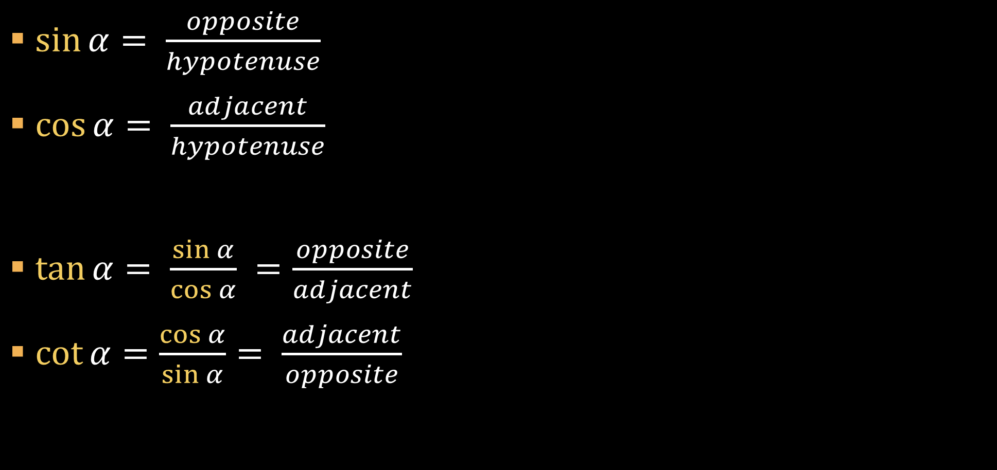
Trigonometric Functions
$\sin{α= \frac{opposite}{hypotenuse}}$
$\cos{α= \frac{adjacent}{hypotenuse}}$
$\tan{α= \frac{\sin{α}}{\cos{α}} =\frac{opposite}{adjacent}}$
$\cot{α=\frac{\cos{α}}{\sin{α}}= \frac{adjacent}{opposite}}$
α

Slide 17

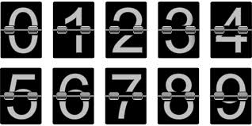
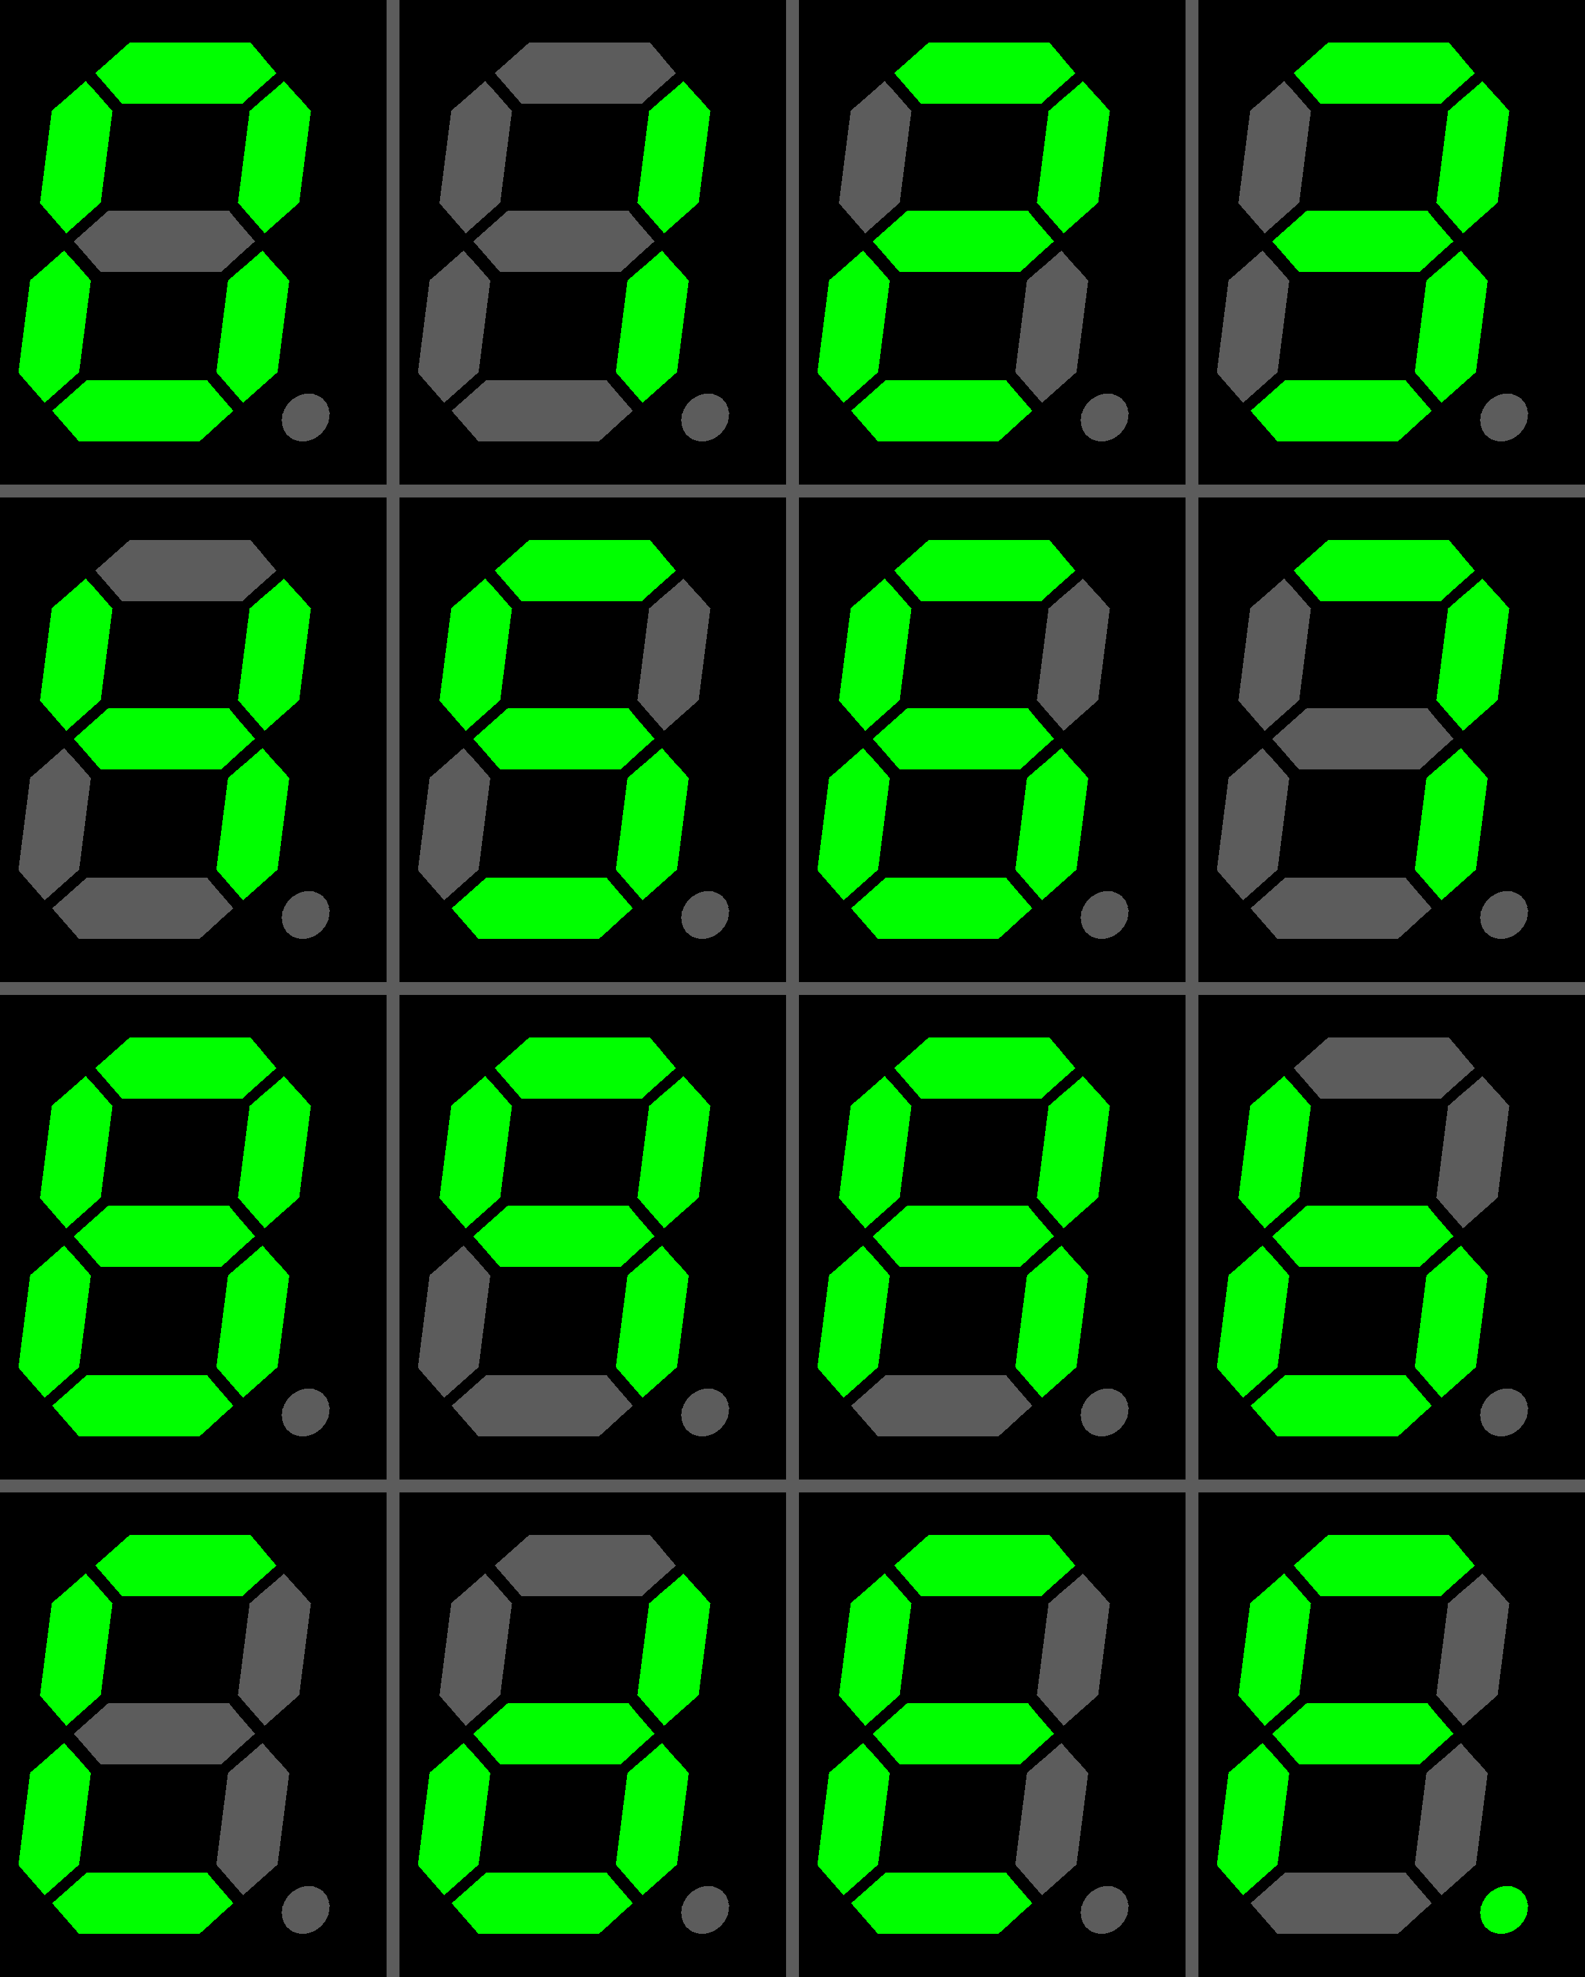
Numeral Systems

Slide 18
Decimal Numeral System
Decimal numbers (base 10)
Represented using 10 numerals: 0, 1, 2, 3, 4, 5, 6, 7, 8, 9
Each position represents a power of 10:
401 = 4*10² + 0*10¹ + 1*10⁰ = 400 + 1
130 = 1*10² + 3*10¹ + 0*10⁰ = 100 + 30
9786 = 9*10³ + 7*10² + 8*10¹ + 6*10⁰ = = 9*1000 + 7*100 + 8*10 + 6*1

Slide 19
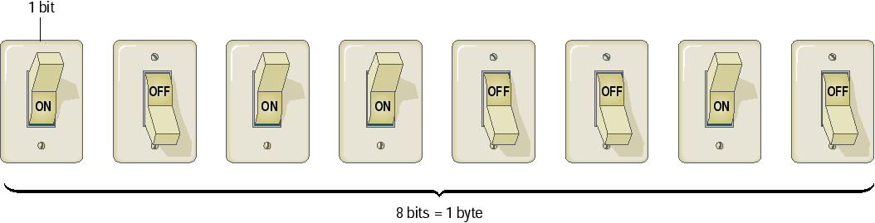
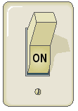

Binary Numeral System
Binary numbers are represented by sequence of bits
Smallest unit of information – 0 or 1
Bits are easy to represent in electronics
1 0 0 1 0 0 1 0
1 0 0 1 0 0 1 1
1 1 1 1 1 1 1 1
1 0 1 1 0 0 1 0

Slide 20
Binary Units of Data
1 B (byte/octet) = 8 bits
1 KB (kilobyte) = 1024 B
1 MB (megabyte) = 1024 KB = 1024 B * 1024 B = 1,048,576 B
1 GB (gigabyte) = 1024 MB = 1024 B * 1024 B * 1024 B =
= 1,073,741,824 B
1 TB (terabyte) = 1024 GB
PB (petabyte), EB (exabyte), ZB (zettabyte), YB (yottabyte)
*HDD 1 GB = 1000 MB * 1000 MB

Slide 21
Binary Numeral System
Binary numbers (base 2)
Represented by 2 numerals: 0 and 1
Each position represents a power of 2:
101_{b} = 1*2² + 0*2¹ + 1*2⁰ = 100_{b} + 1_{b} = = 4 + 1 = 5
110_{b} = 1*2² + 1*2¹ + 0*2⁰ = 100_{b} + 10_{b} = = 4 + 2 = 6
110101_{b} = 1*2⁵ + 1*2⁴ + 0*2³ + 1*2² + 0*2¹ + 1*2⁰ =
= 32 + 16 + 4 + 1 = 53

Slide 22
Binary to Decimal Conversion
Multiply each numeral by its exponent:
1001_{b} = 1*2³ + 1*2⁰ = 1*8 + 1*1 =
= 9
0111_{b} = 0*2³ + 1*2² + 1*2¹ + 1*2⁰ = = 100_{b} + 10_{b} + 1_{b} = 4 + 2 + 1 =
= 7
110110_{b} = 1*2⁵ + 1*2⁴ + 0*2³ + 1*2² + 1*2¹ = = 100000_{b} + 10000_{b} + 100_{b} + 10_{b} = = 32 + 16 + 4 + 2 = = 54

Slide 23

Decimal to Binary Conversion
Divide by 2 and append the reminders in reversed order:
500/2 = 250 (0)
250/2 = 125 (0)
125/2 = 62 (1)
62/2 = 31 (0)
31/2 = 15 (1)
15/2 = 7 (1)
7/2 = 3 (1)
3/2 = 1 (1)
1/2 = 0 (1)
500_{d} = 111110100_{b}

Slide 24
Binary Examples
01010011
01101111
01100110
01110100
01010101
01101110
01101001
Binary
83
111
102
116
85
110
105
ASCII(Dec)
S
o
f
t
U
n
i
Symbols

Slide 25

Binary systems
Exercise

Slide 26
Hexadecimal Numeral System
Hexadecimal numbers (base 16)
Represented using 16 numerals: 0, 1, 2, 3, 4, 5, 6, 7, 8, 9, A, B, C, D, E and F
In programming usually prefixed with 0x
0 → 0x0 4 → 0x4 8 → 0x8 12 → 0xC
1 → 0x1 5 → 0x5 9 → 0x9 13 → 0xD
2 → 0x2 6 → 0x6 10 → 0xA 14 → 0xE
3 → 0x3 7 → 0x7 11 → 0xB 15 → 0xF

Slide 27
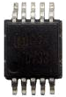
Hexadecimal to Decimal Conversion
Multiply each digit by its exponent:
1F4_{hex} = 1*16² + 15*16¹ + 4*16⁰ =
= 1*256 + 15*16 + 4*1 =
= 500_{d}
FF_{hex} = 15*16¹ + 15*16⁰ = 240 + 15 =
= 255_{d}
1D_{hex} = 1*16¹ + 13*16⁰ = 16 + 13 =
= 29_{d}

Slide 28
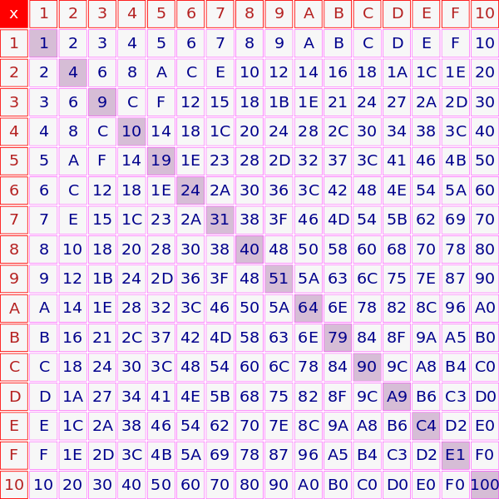
Decimal to Hexadecimal Conversion
Divide by 16 and append the reminders in reversed order
500/16 = 31 (4)
31/16 = 1 (F)
1/16 = 0 (1)
500_{d} = 1F4_{hex}

Slide 29
Binary to Hexadecimal Conversion
Straightforward conversion from binary to hexadecimal
Each hex digit corresponds to a sequence of 4 binary digits:
Works both directions
0x0 = 0000 0x8 = 1000 0x1 = 0001 0x9 = 1001 0x2 = 0010 0xA = 1010 0x3 = 0011 0xB = 1011 0x4 = 0100 0xC = 1100 0x5 = 0101 0xD = 1101 0x6 = 0110 0xE = 1110 0x7 = 0111 0xF = 1111

Slide 30
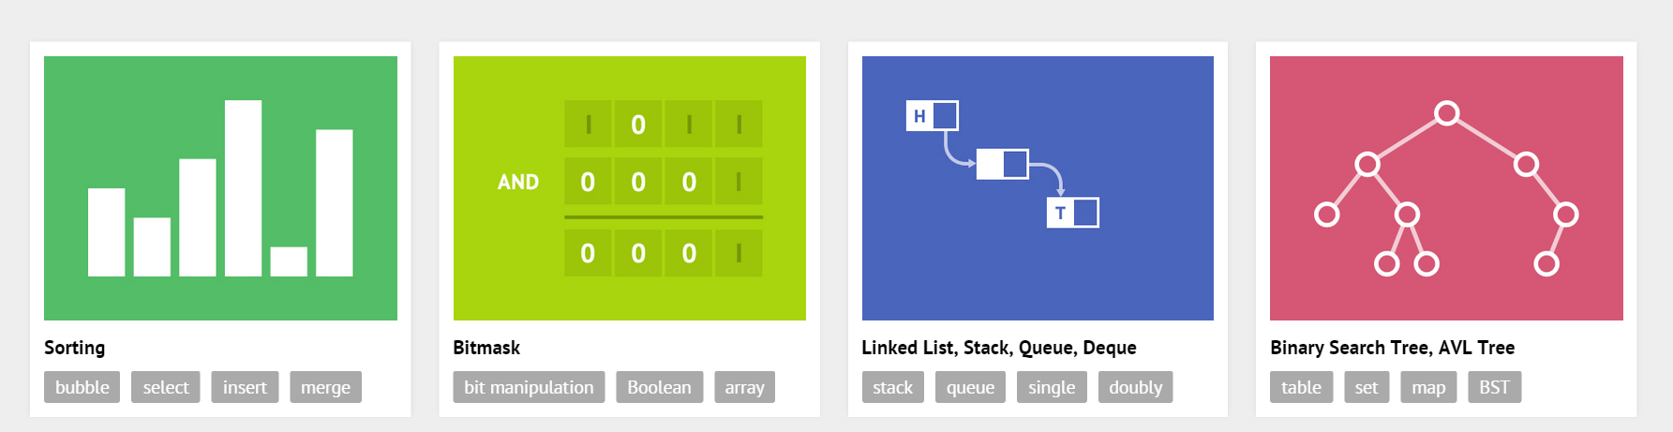
Algorithms

Slide 31
What is Algorithm?
A step-by-step procedure for calculations
A set of rules that precisely defines a sequence of operations
The set should be finite
The sequence should be fully defined
Usage:
In science for calculation, data processing, automated reasoning
In our everyday lives like morning routine, commute, etc.
In programming – every program is algorithm if it eventually stops

Slide 32
Algorithm – Check if Integer (X) is Prime
Check if X is less than or equal to 1
If Yes, then X is not prime
Check if X is equal to 2
If Yes, then X is prime
Start from 2 try any integer up to X-1. Check if it divides X
If Yes, then X is not prime
Examples: 1, 2, 6, 7, -2

Slide 33
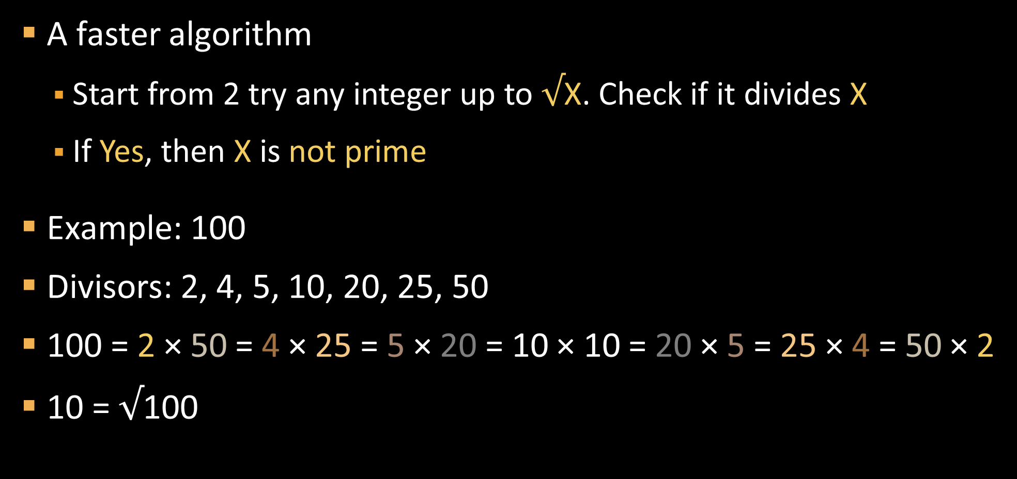
Algorithm – Check if Integer X is Prime (2)
A faster algorithm
Start from 2 try any integer up to $√$X. Check if it divides X
If Yes, then X is not prime
Example: 100
Divisors: 2, 4, 5, 10, 20, 25, 50
100 = 2 × 50 = 4 × 25 = 5 × 20 = 10 × 10 = 20 × 5 = 25 × 4 = 50 × 2
10 = $√$100

Slide 34
Algorithm – Greatest Common Divisor (GCD)
Find the largest positive integer that divides both numbers A & B without a remainder – GCD(A, B)
Check if A or B is equal to 0
If one is equal to 0, then the GCD is the other
If both are equal to 0, then the GCD is 0
Find all divisors of A and B
Find the largest among the two groups
Examples: 4 and 12, 24 and 54, 24 and 60, 2 and 0

Slide 35
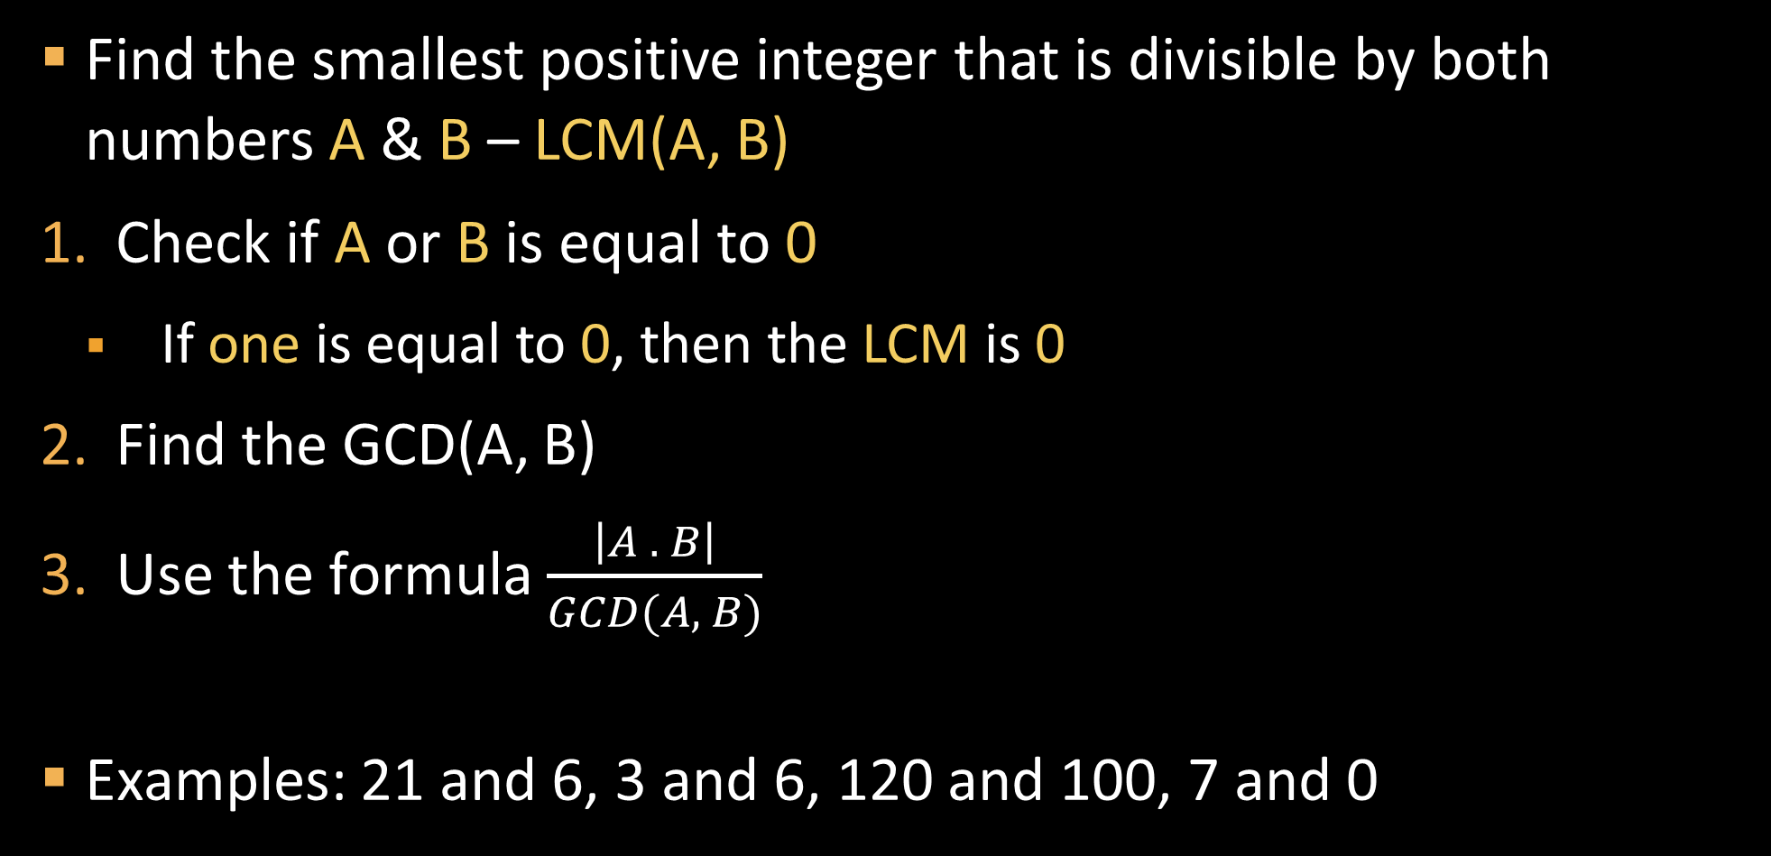
Algorithm – Least Common Multiple (LCM)
Find the smallest positive integer that is divisible by both numbers A & B – LCM(A, B)
Check if A or B is equal to 0
If one is equal to 0, then the LCM is 0
Find the GCD(A, B)
Use the formula $\frac{\left|A . B\right|}{GCD(A, B)}$
Examples: 21 and 6, 3 and 6, 120 and 100, 7 and 0

Slide 36
Sorting Algorithms
Live Demo
http://visualgo.net
http://www.sorting-algorithms.com

Slide 37

Summary
Mathematical definitions
Sets, factorial, vectors, matrices
Geometry and trigonometry basics
Cartesian coordinate system
Trigonometric functions
Numeral systems
Binary, decimal, hexadecimal
Algorithms: definition and examples

Slide 38








Programming Basics – Course Introduction
https://softuni.bg/courses/programming-basics/

Slide 39
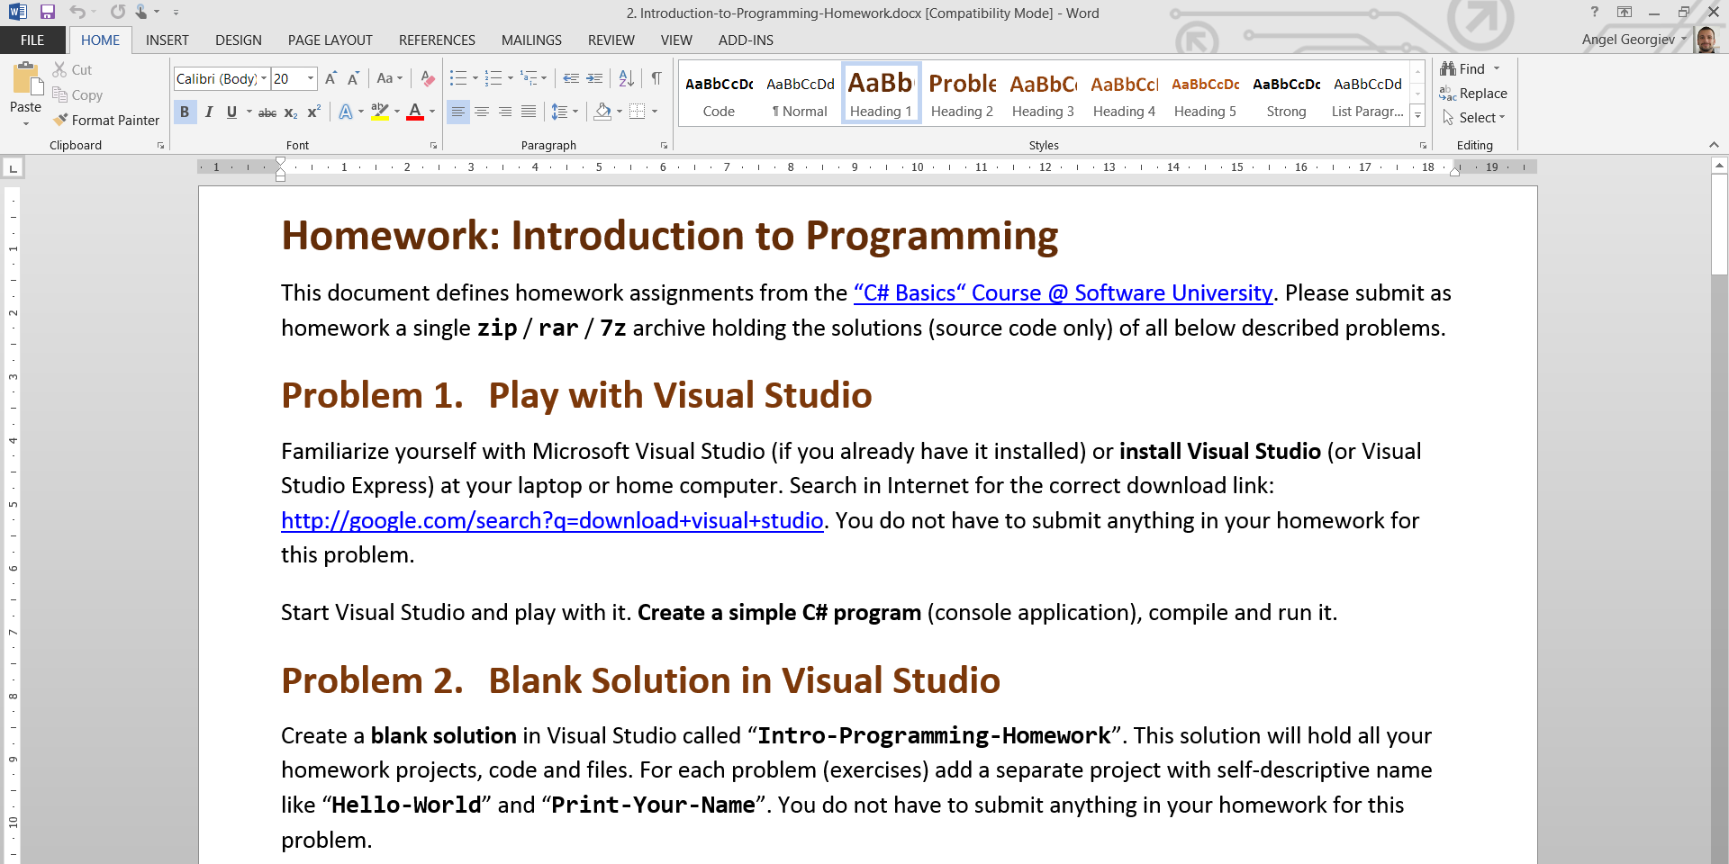
Homework Review
Live Demo

Slide 40
License
This course (slides, examples, demos, videos, homework, etc.) is licensed under the "Creative Commons Attribution-NonCommercial-ShareAlike 4.0 International" license
Attribution: this work may contain portions from
"Fundamentals of Computer Programming with C#" book by Svetlin Nakov & Co. under CC-BY-SA license
"C# Part I" course by Telerik Academy under CC-BY-NC-SA license

Slide 41






Free Trainings @ Software University
Software University Foundation – softuni.org
Software University – High-Quality Education, Profession and Job for Software Developers
softuni.bg
Software University @ Facebook
facebook.com/SoftwareUniversity
Software University @ YouTube
youtube.com/SoftwareUniversity
Software University Forums – forum.softuni.bg

